Slide 1
Creating a simple Echo Application in XV6
-Sireejaa Uppal

Slide 2
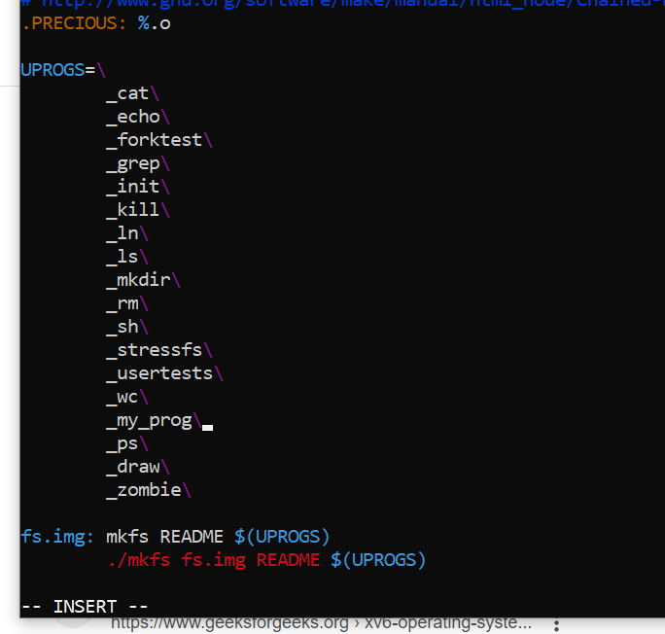
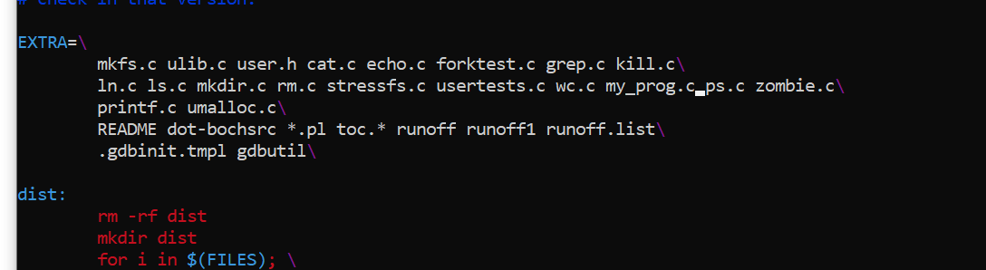
Add my_prog declaration in make file.

Slide 3
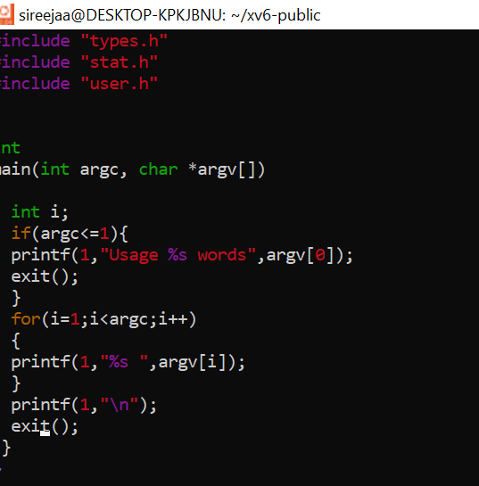
Create my_prog.c

Slide 4
Compile and Run
1.make
2.make qemu-nox
Note for debugging : Incase it doesn’t compile check for the errors and resolve in my_prog.c by checking for the line number in error status

Slide 5


Compile & Run
Make
Qemu

Slide 6
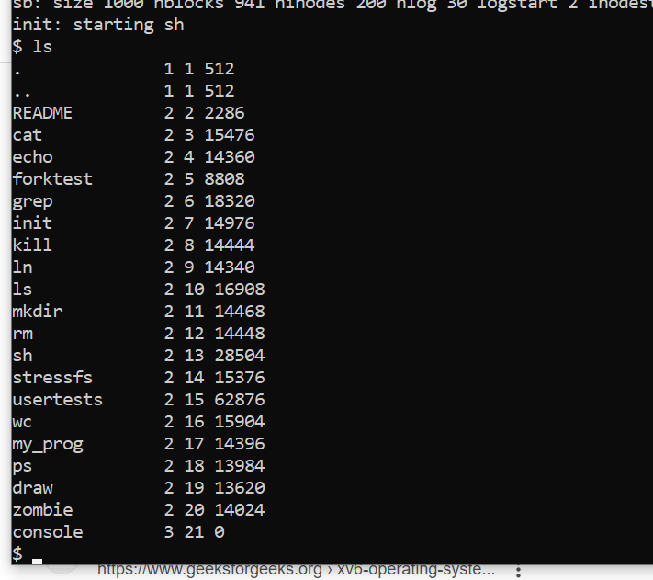
Ls to check if your program is present in the list

Slide 7
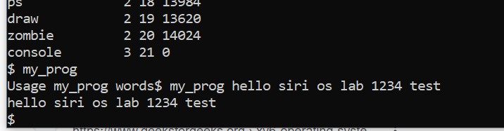
Type your application name and hit enter
Type a few characters after program name and it will be echoed

Slide 8
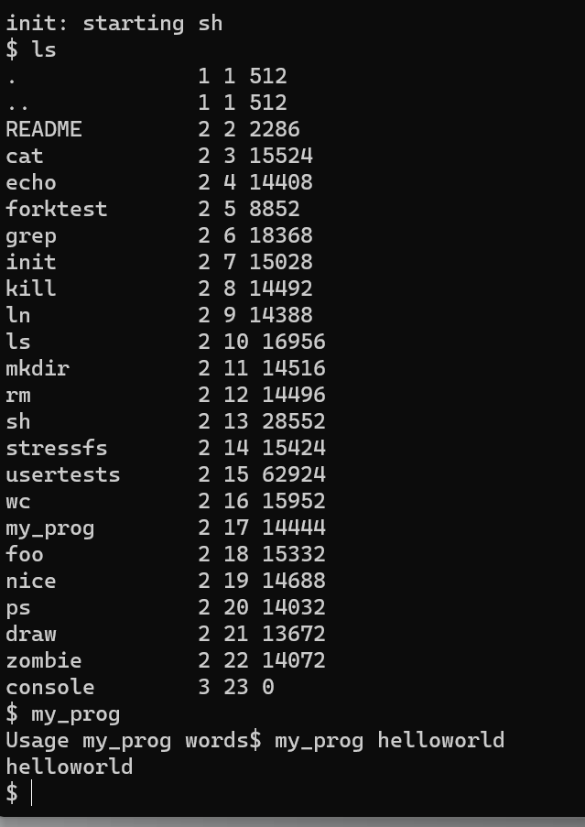
Output

Slide 9
Thank You!!

Slide 10

cp wc.c simple.c

